Slide 1
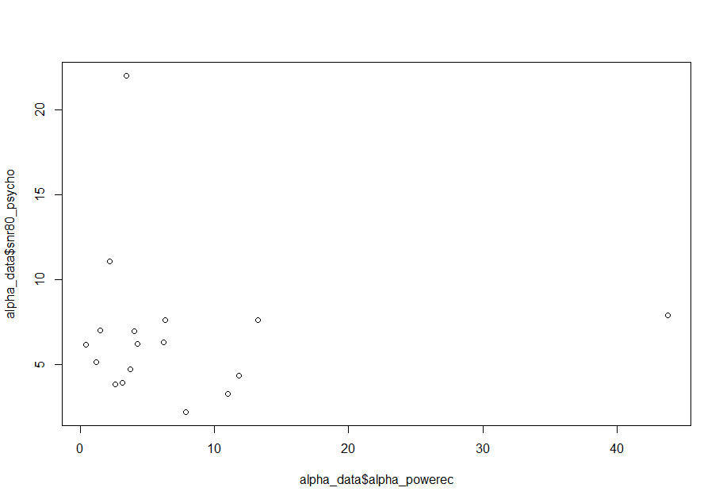
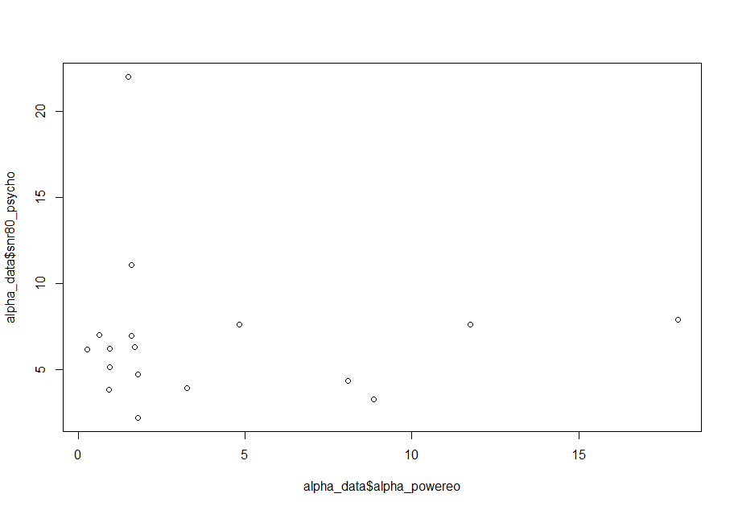
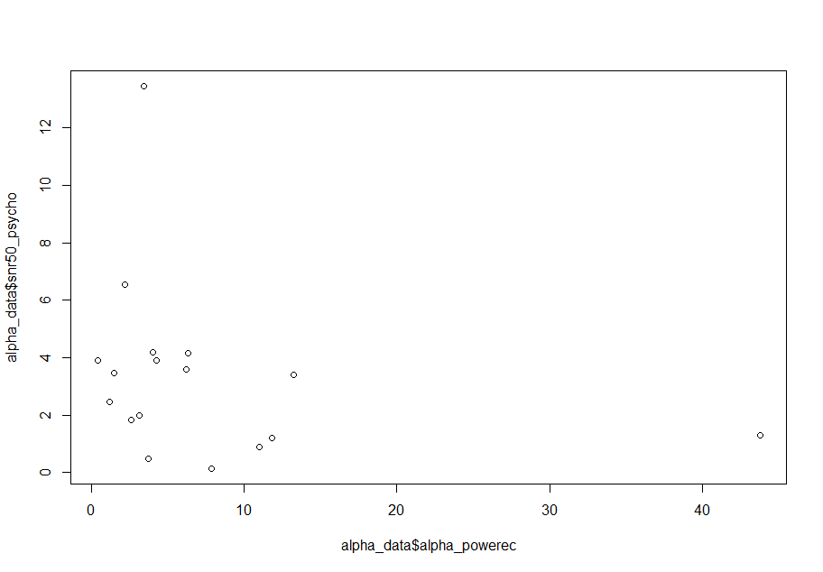
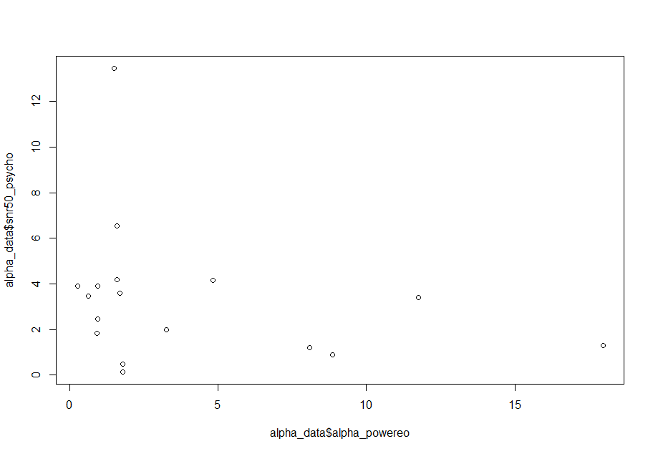
Alpha peak power (Averaged alpha power within ±2 hz band of peak )
SNR 80, Eyes closed
SNR 80, Eyes open
SNR 50, Eyes closed
SNR 50, Eyes open

Slide 2
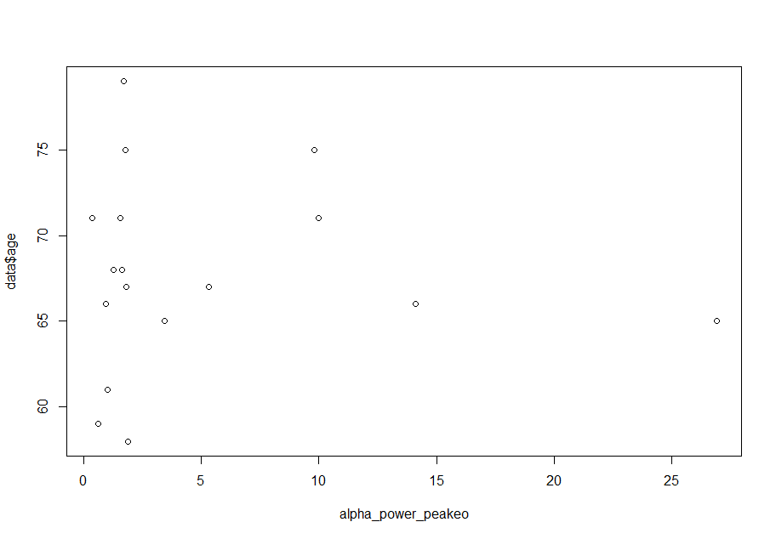

Alpha eyes open vs Age
Alpha closed vs Age

Slide 3
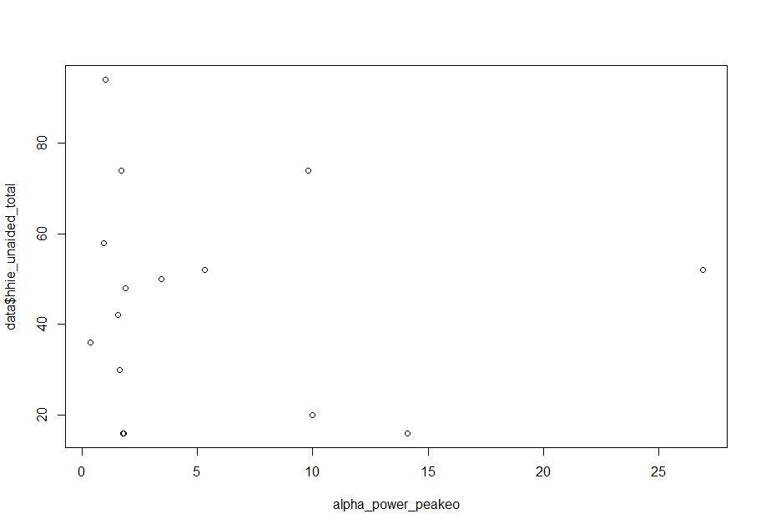

Alpha eyes open vs HHIE unaided
Alpha eyes closed vs HHIE unaided

Slide 4
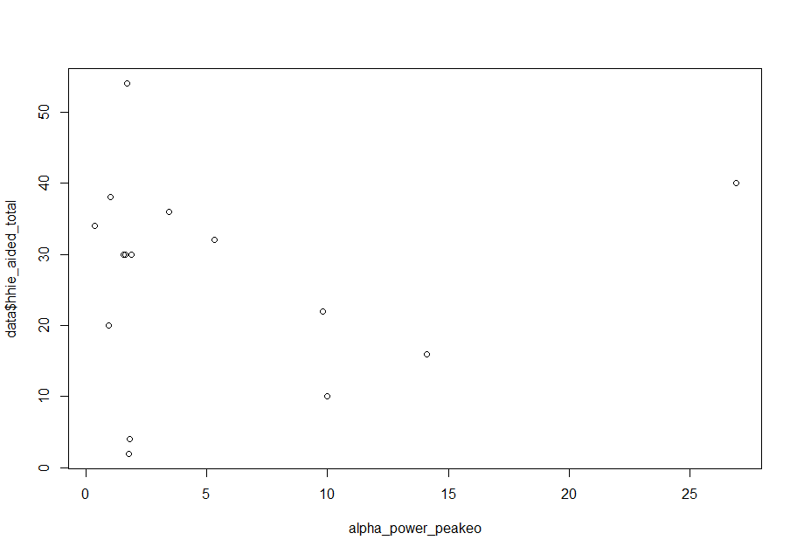
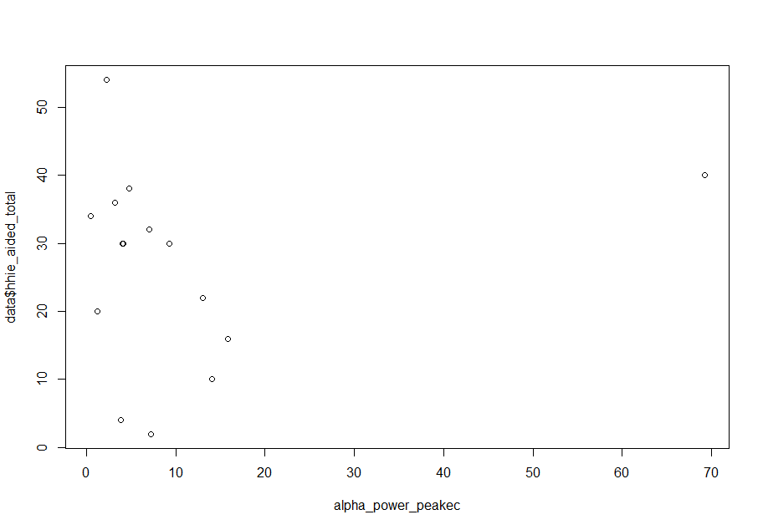
Alpha eyes open vs HHIE unaided
Alpha eyes closed vs HHIE unaided

Slide 5
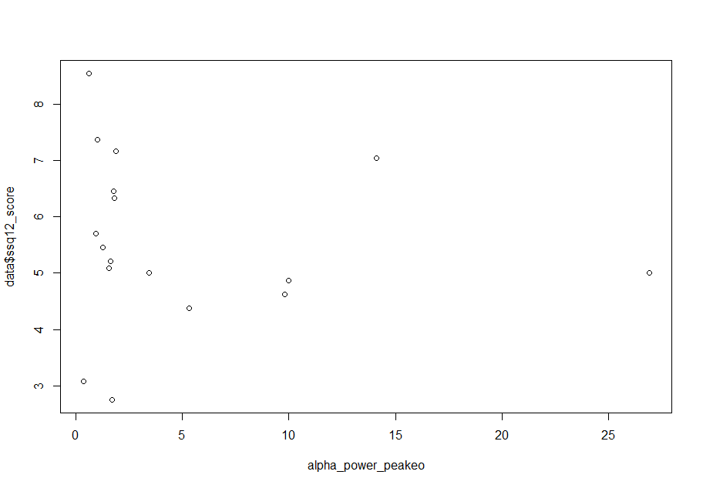
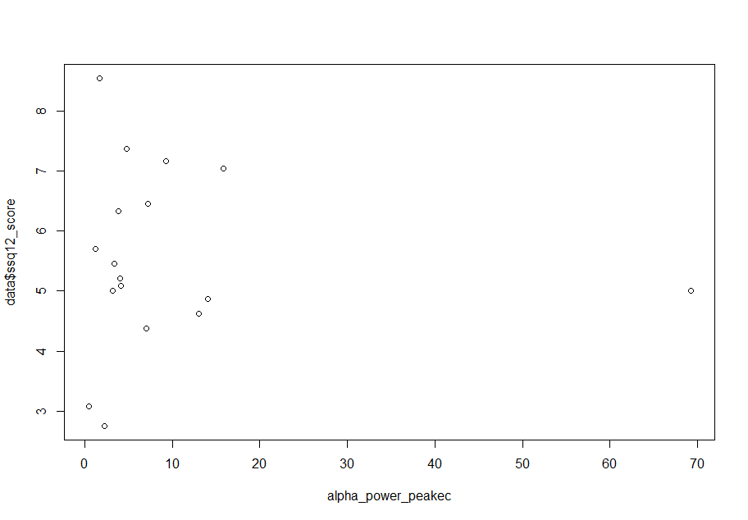
Alpha eyes open vs SSQ12
Alpha eyes closed vs SSQ12

Slide 6
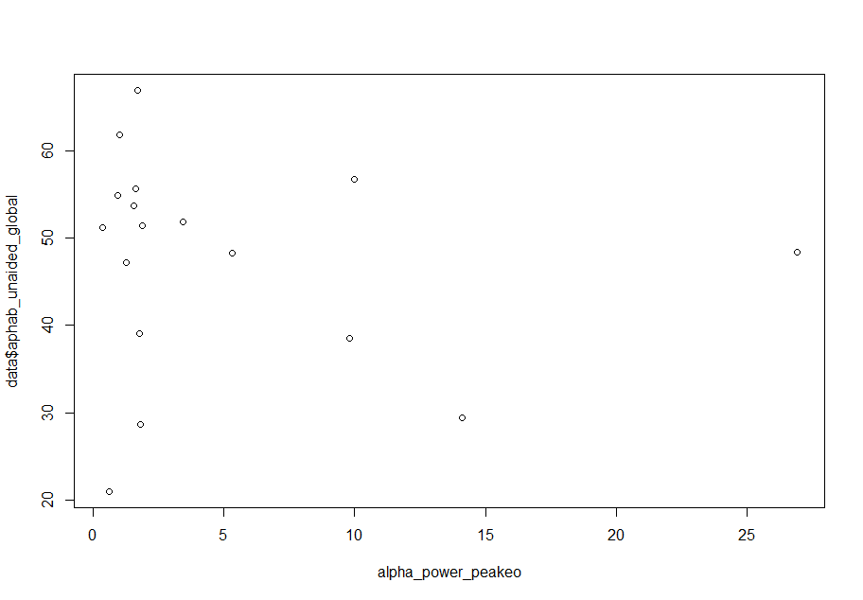
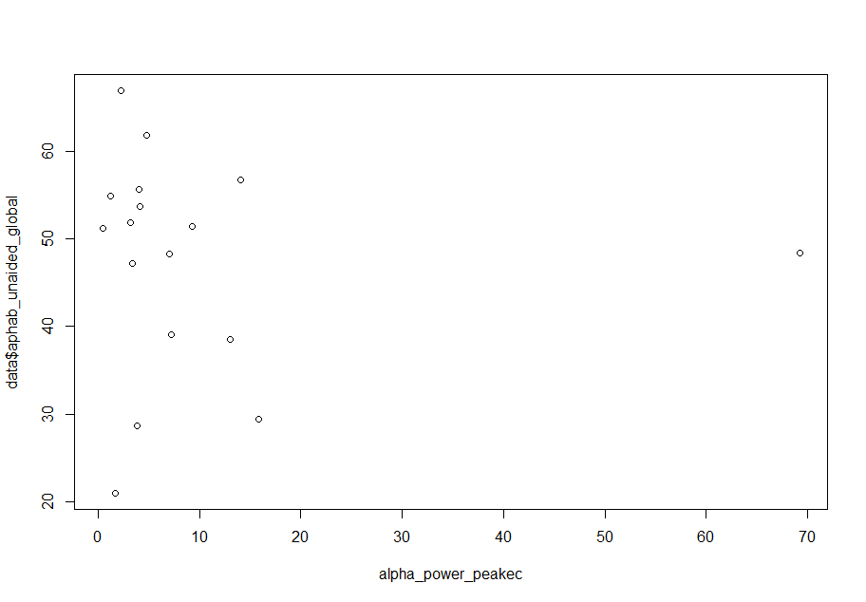
Alpha eyes open vs Aphab_unaided_global
Alpha eyes closed vs Aphab_unaided_global

Slide 7
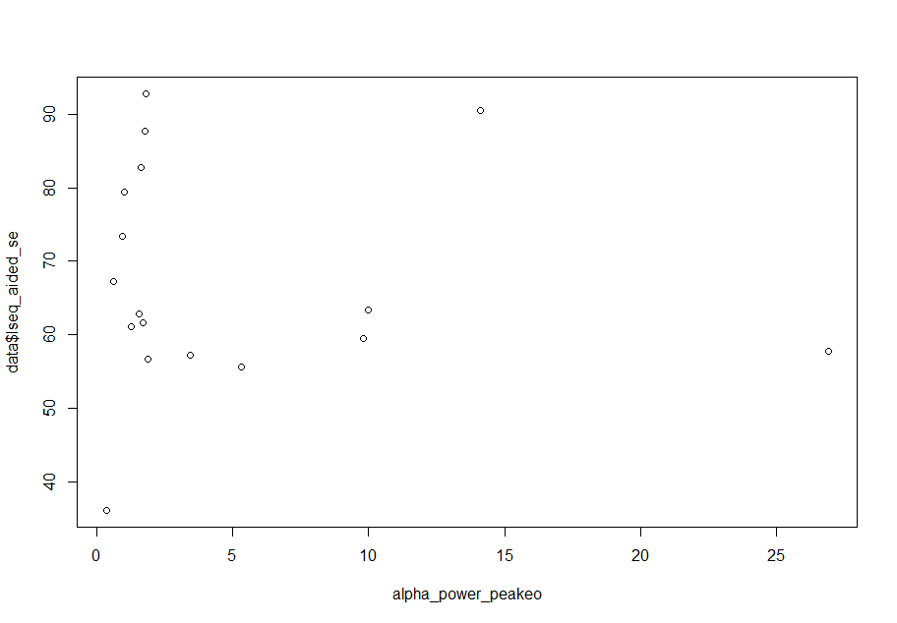
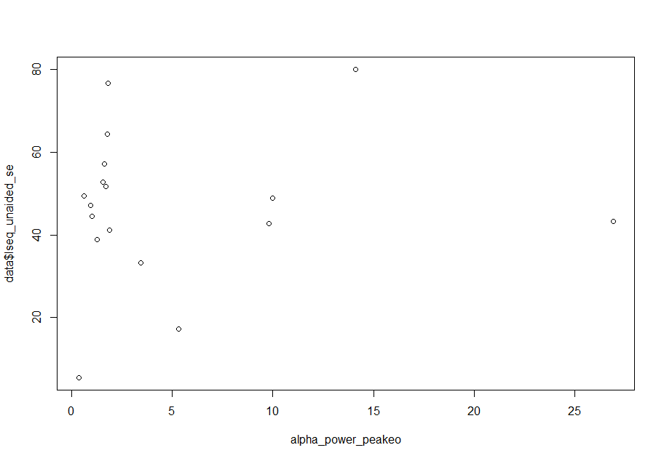
Alpha eyes open vs LSEQ_aided_se
Alpha eyes closed vs LSEQ_unaided_se

Slide 8
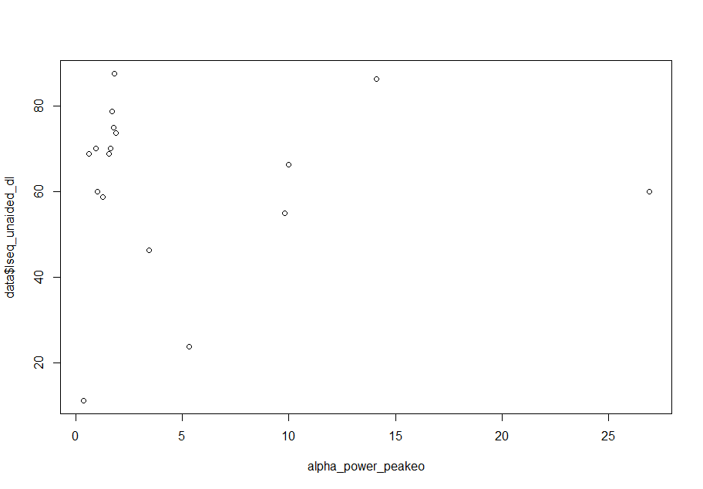
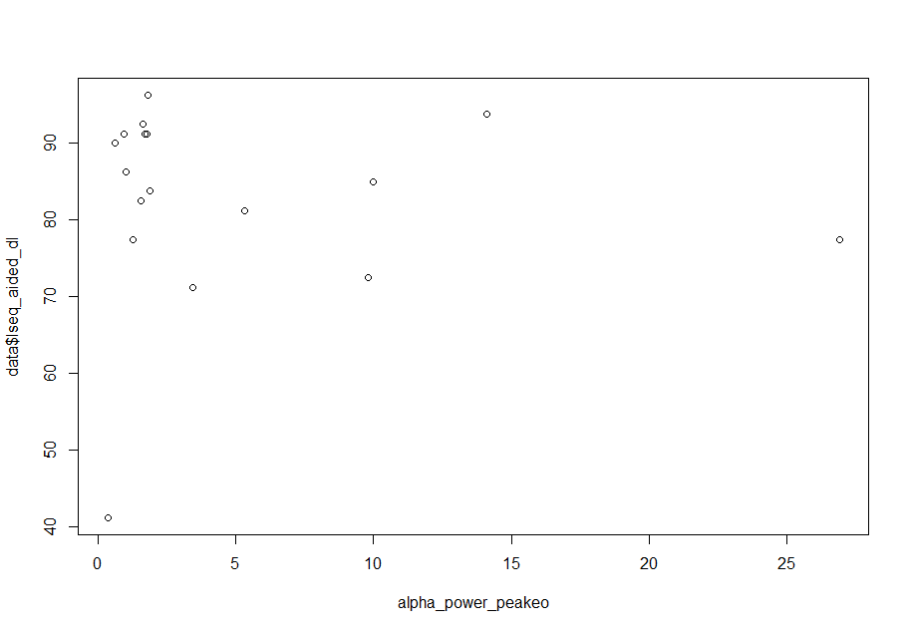
Alpha eyes open vs LSEQ_aided_dl
Alpha eyes closed vs LSEQ_unaided_dl

Slide 9

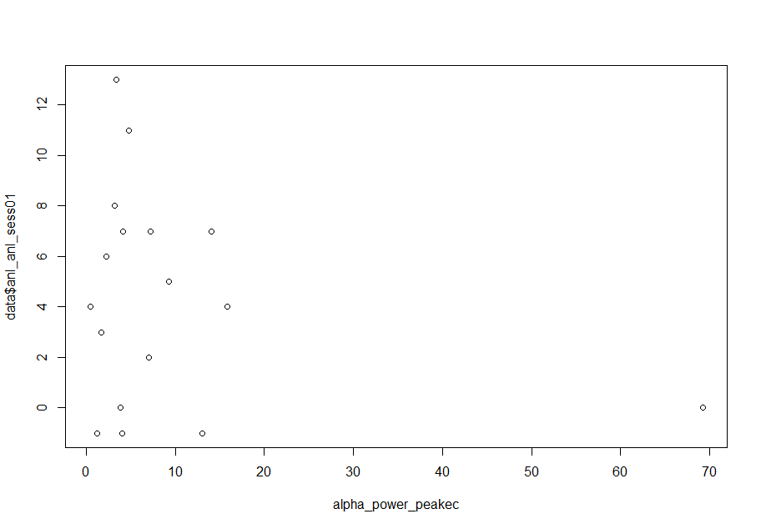
Alpha eyes open vs anl
Alpha eyes closed vs anl

Slide 10
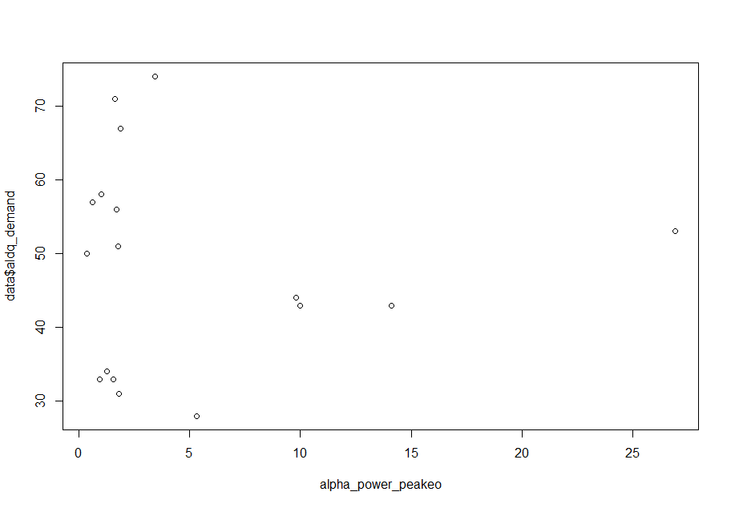
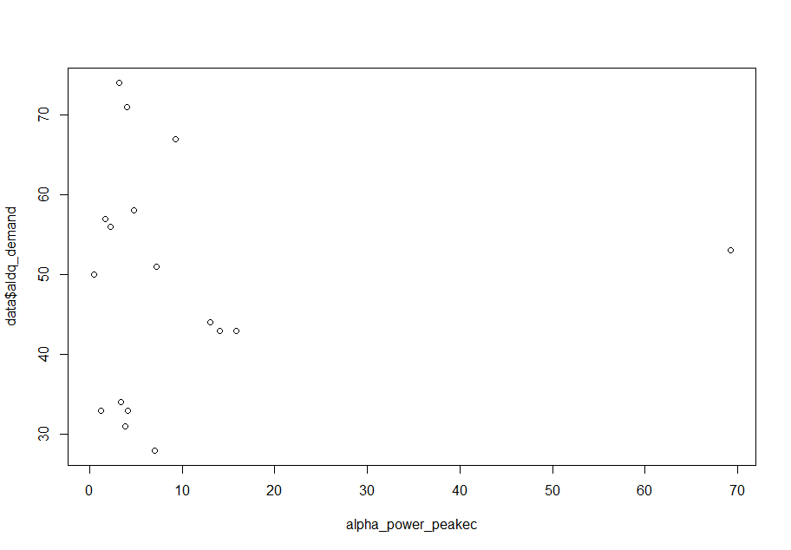
Alpha eyes open vs ALDQ_demand
Alpha eyes closed vs ALDQ_demand

Slide 11
Significant correlations

Slide 12
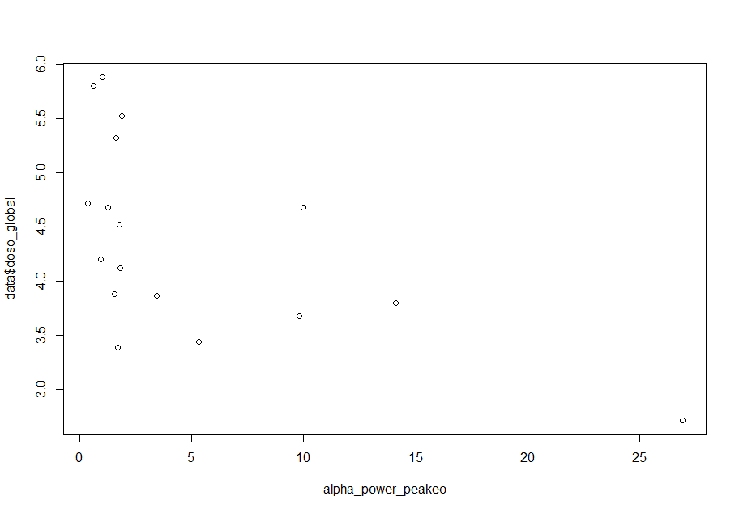
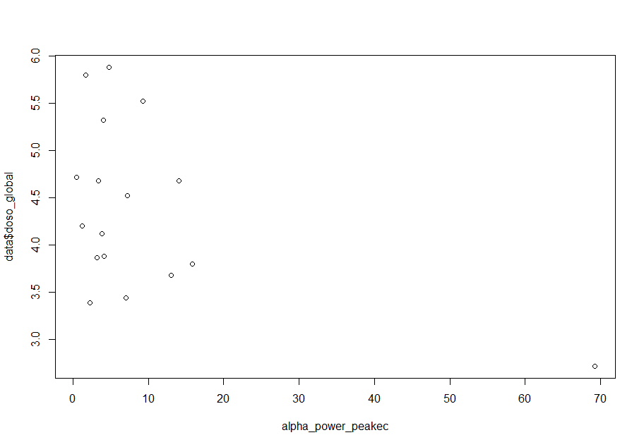
Alpha eyes open vs DOSO_global
Alpha eyes closed vs DOSO_global

Slide 13
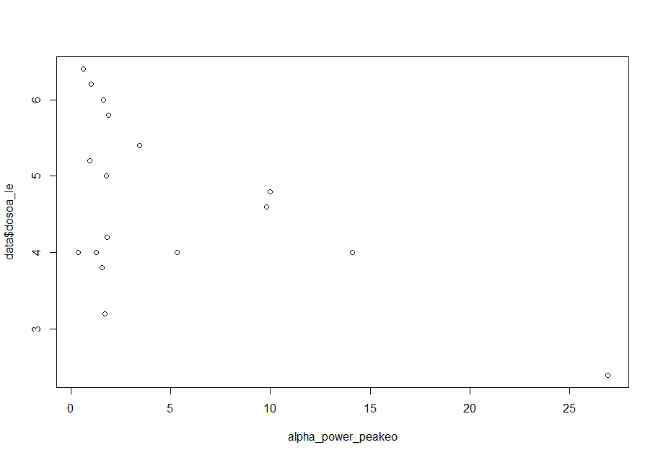
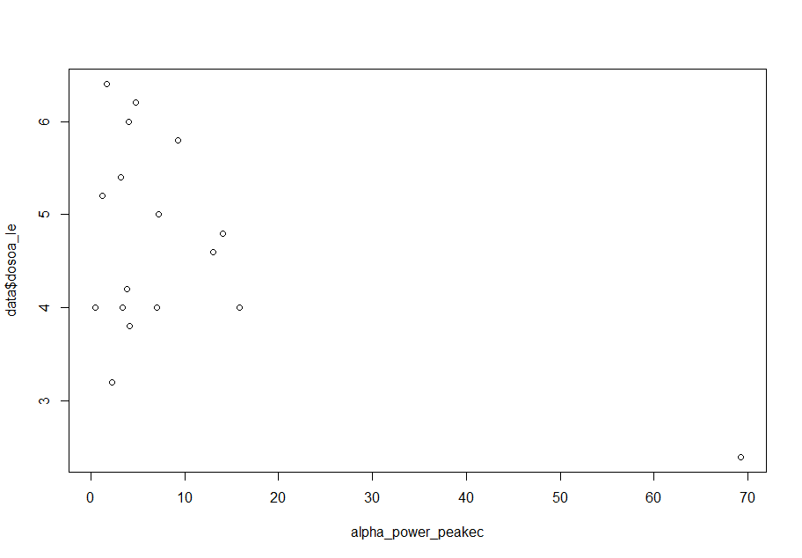
Alpha eyes open vs DOSOA_LE
Alpha eyes closed vs DOSOA_LE

Slide 14
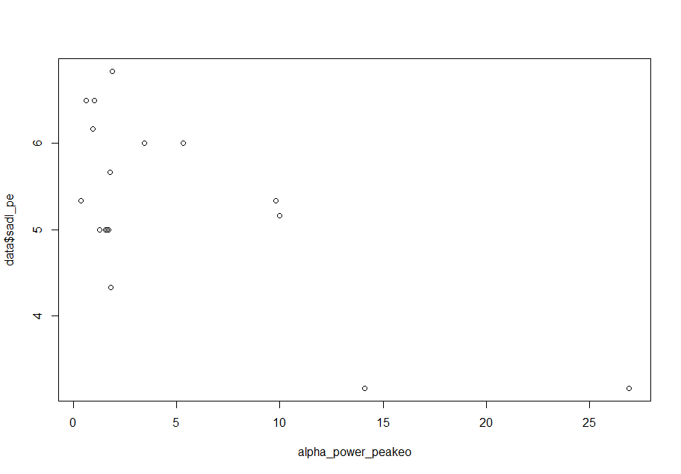
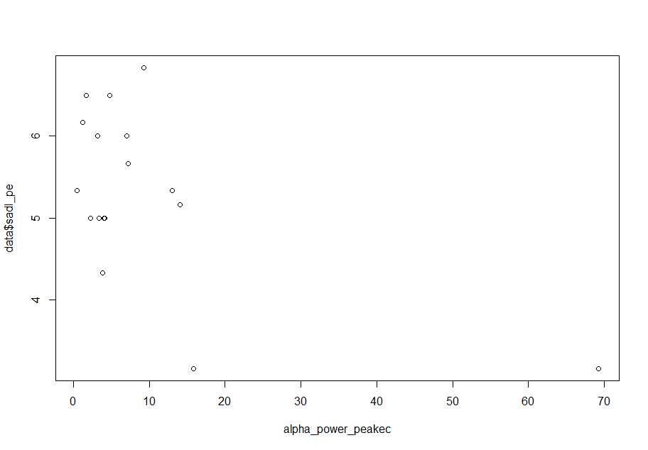
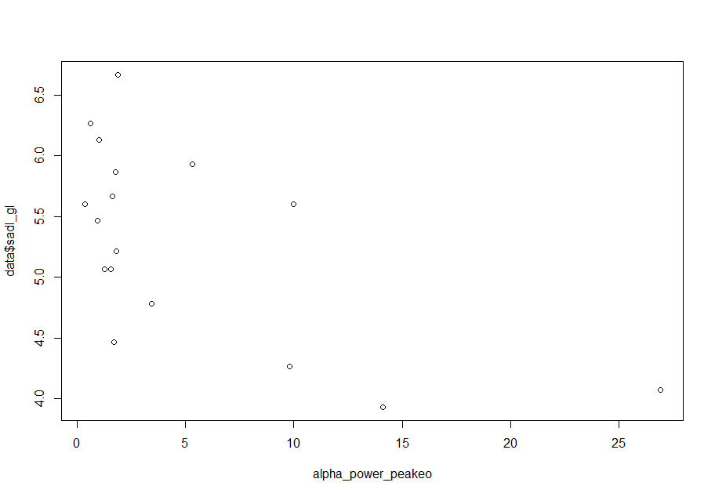
Alpha eyes open vs Sadl_pe
Alpha eyes closed vs Sadl_pe
Alpha eyes open vs Sadl_gl

